Slide 1
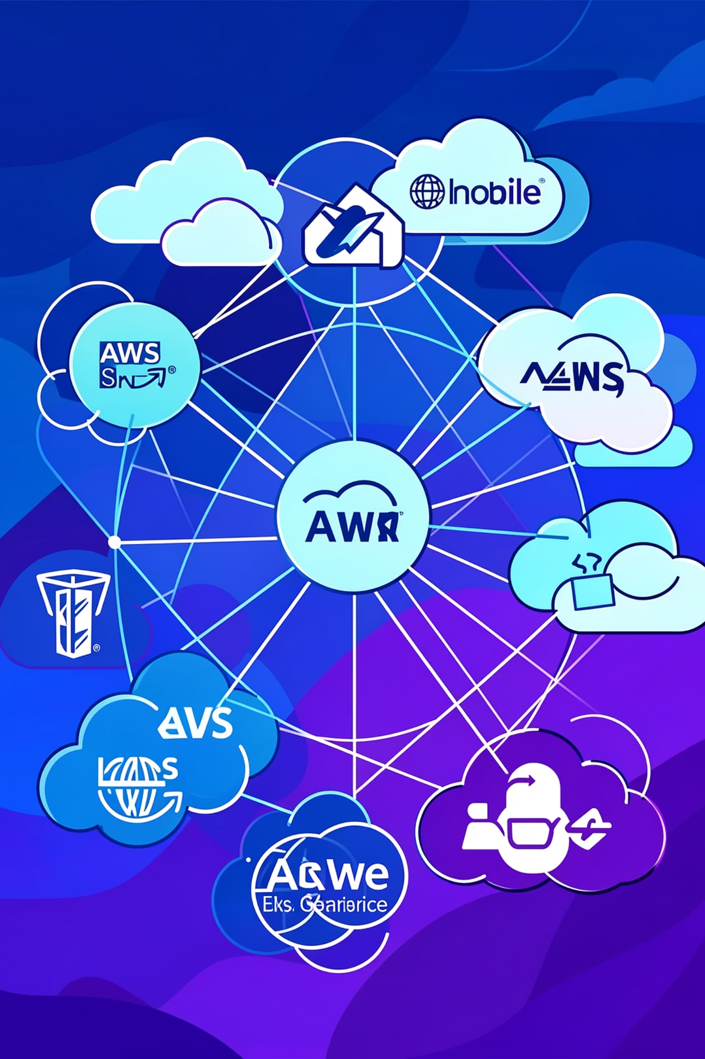
Mastering AWS Infrastructure as Code
A comprehensive guide to CloudFormation and CDK for cloud engineers.

Slide 2
What is AWS CloudFormation?
AWS CloudFormation is an Infrastructure as Code (IaC) service that allows you to provision and manage AWS resources using declarative templates. Instead of manually creating resources, you define your desired infrastructure in code.
AWS-Native IaC
Leverages the full power of AWS services.
This approach offers consistency, repeatability, and version control for your cloud environment.
Declarative Language
Define the desired end state, CloudFormation handles the rest.
JSON / YAML Templates
Flexible syntax for defining your infrastructure.

Slide 3
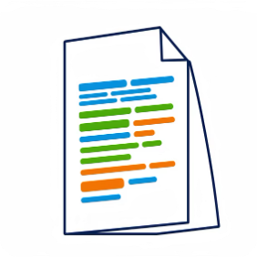
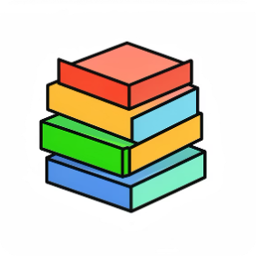
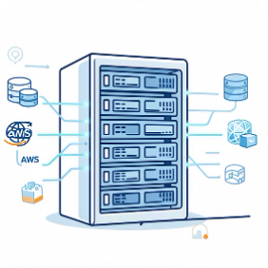

Key Components of CloudFormation
Templates
Stacks
Resources
Outputs
The blueprint for your AWS resources, written in JSON or YAML.
A collection of AWS resources provisioned by a single template.
Values from your stack that can be easily referenced or exported.
The actual AWS services (EC2 instances, S3 buckets, etc.) defined in your template.

Slide 4
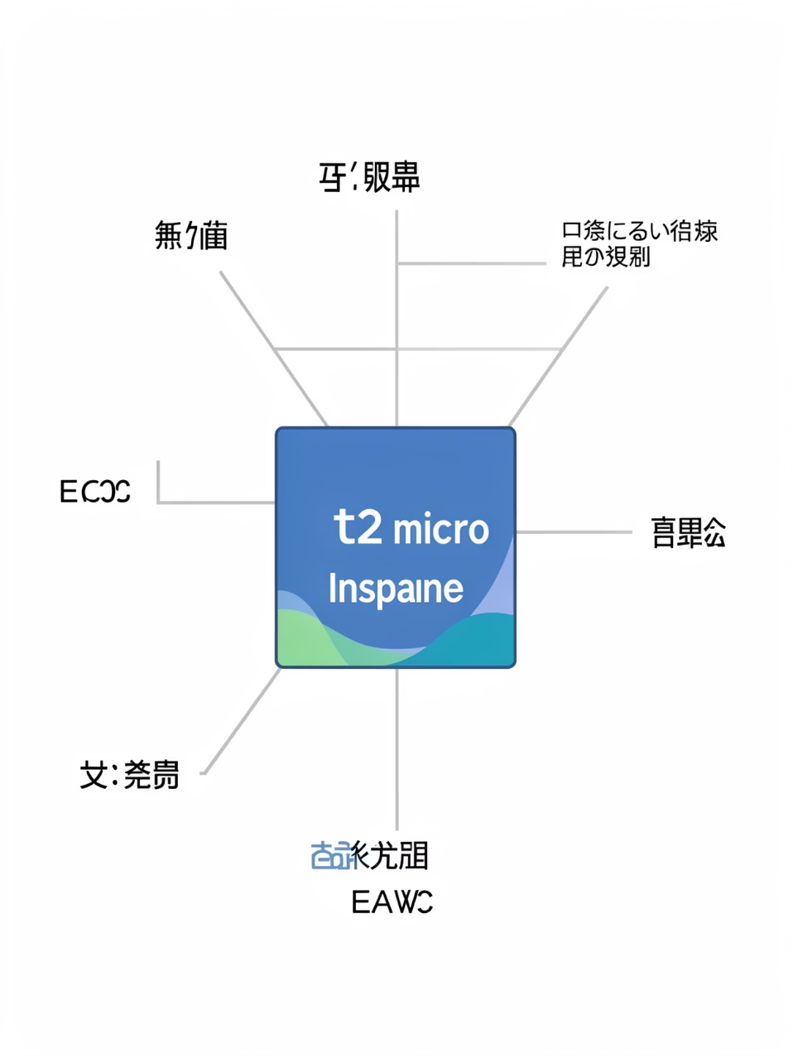
CloudFormation Template Example: EC2 Instance
AWSTemplateFormatVersion: '2010-09-09' Description: A simple EC2 instance Resources: MyEC2Instance: Type: AWS::EC2::Instance Properties: InstanceType: t2.micro ImageId: ami-0abcdef1234567890 Tags: - Key: Name Value: MyWebServer
This YAML template defines a single EC2 instance named MyEC2Instance. It specifies the instance type as t2.micro and uses a placeholder ImageId for the Amazon Machine Image. Tags are also included for easy identification.

Slide 5

Stack Creation & Management
Essential CLI Commands
# Create a new stack aws cloudformation create-stack \ --stack-name demo-ec2 \ --template-body file://ec2.yml \ --region us-east-1 # Describe existing stacks aws cloudformation describe-stacks \ --stack-name demo-ec2 # Delete a stack aws cloudformation delete-stack \ --stack-name demo-ec2
Managing CloudFormation stacks is primarily done through the AWS CLI or console. You can create, update, and delete stacks with simple commands, enabling full lifecycle management of your infrastructure.

Slide 6

Advanced CloudFormation Features
Parameters
Mappings
Conditions
Customize template inputs at runtime (e.g., instance type, environment).
Define conditional values based on region or other criteria.
Control resource creation based on logical conditions.
Parameters: InstanceType: Type: String Default: t2.micro Description: EC2 instance type
Nested Stacks
Rollback Behavior
Modularize templates for complex architectures.
Automatic rollback to a known good state in case of deployment failures.

Slide 7

What is AWS Cloud Development Kit (CDK)?
TypeScript
Define infrastructure using JavaScript's superset.
Python
Leverage Python for infrastructure definitions.
Java
Build your cloud resources with Java.
AWS CDK is an open-source software development framework for defining cloud infrastructure in familiar programming languages. It compiles your code into CloudFormation templates, offering a higher level of abstraction and development efficiency.
C#
Utilize C# for .NET-based infrastructure.

Slide 8
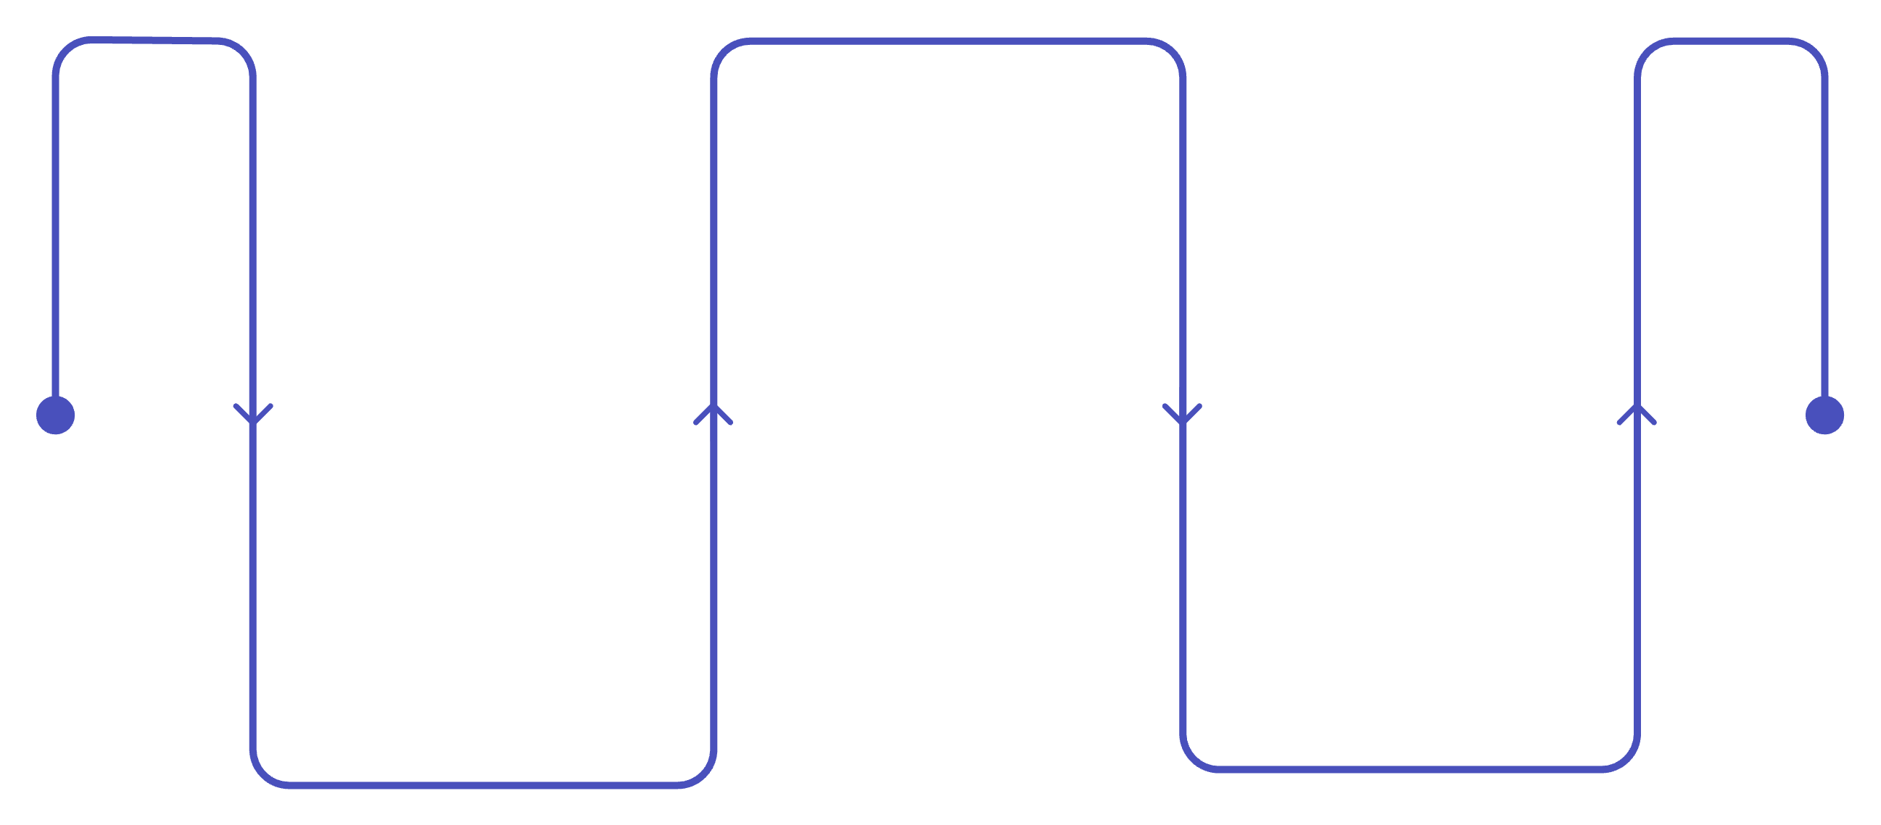
Simple CDK Workflow
Synthesize
Generate CloudFormation templates
Initialize
Deploy
Create a new CDK app
Apply the stack to AWS
The CDK simplifies infrastructure deployment by abstracting away the raw CloudFormation. You write code, synthesize it into CloudFormation, and then deploy it to AWS.
# 1. Initialize a new CDK app cdk init app --language python # 2. Synthesize to CloudFormation cdk synth # 3. Deploy to AWS cdk deploy

Slide 9
CloudFormation vs. CDK vs. Terraform
Multi-cloud Support
Yes
No (AWS only)
No (AWS focused)
State Management
Managed by Terraform
Managed by AWS
Managed by AWS
Language
HCL
YAML / JSON
TypeScript, Python, etc.
Modularity
Modules
Nested Stacks
Constructs
Abstraction Level
Low-Medium
Low
High
Choosing the right IaC tool depends on your specific needs, team expertise, and multi-cloud strategy.

Slide 10


Key Takeaways & Next Steps
CloudFormation: Foundation
CDK: Abstraction & Velocity
IaC: Best Practice
Essential for scalable, reliable cloud infrastructure.
The declarative core for AWS resource provisioning.
Builds on CloudFormation with familiar programming languages.
Start experimenting with simple templates and constructs. The best way to learn is by doing!

